Slide 1




SMART PSIT HACKATHON 2025
ATHLELUNG
Problem Statement ID- N/A
Problem Statement Title- Student Innovation
Theme- Fitness & Sports
PS Category- Hardware
Team ID- SPH_126
Team Name- GL!TCH

Slide 2
ATHLELUNG
GL!TCH
Our solution is a low-cost, portable ventilator system, designed to provide immediate respiratory support to athletes during emergencies such as breathlessness or collapses on the field; it uses a knob to adjust air delivery based on need, offering a unique, compact, and field-ready alternative to traditional ventilators, making it ideal for deployment at sports events, fitness centers, and training grounds where immediate medical equipment is often unavailable.

Slide 3
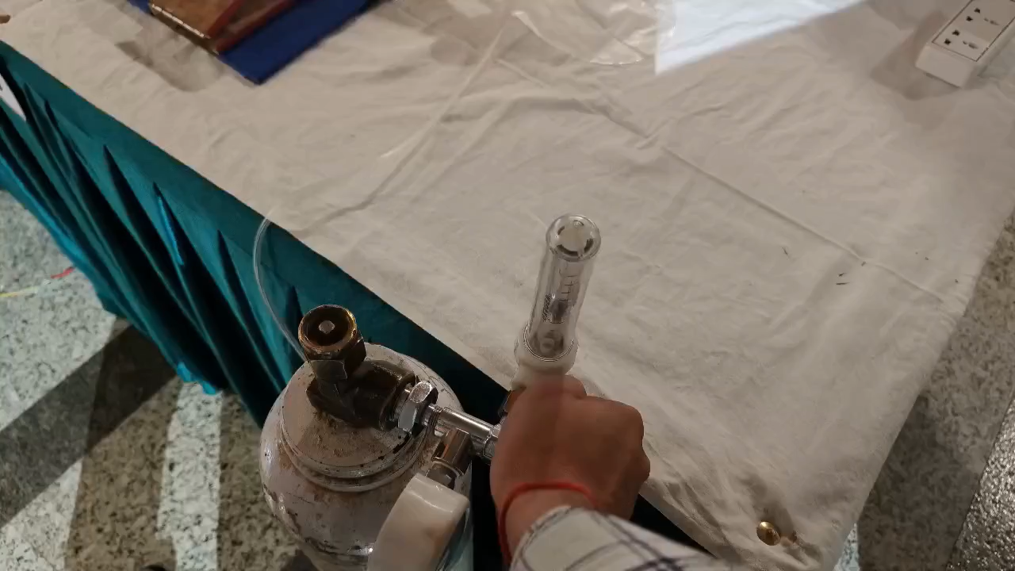
TECHNICAL APPROACH
GL!TCH
Hardware Used - Arduino Uno, Servo motor(MG996R), Ambu bag, Potentiometer, Breadboard, Wires, LCD display, I2C Module
Working prototype -

Slide 4
FEASIBILITY AND VIABILITY
GL!TCH
Feasibility: The system is feasible using affordable components like Arduino, servo motors, and Ambu bags, with a low-cost and portable design ensuring easy deployment in emergencies. Its modular setup allows for easy scalability across different sports environments.
Challenges and Risks: Power reliability, servo motor performance under stress, quick user adoption, regulatory approvals.
Strategies for Overcoming: Use high-quality batteries, conduct extensive testing under varied conditions for reliability, provide clear user instructions, engage with regulatory bodies early, and design the system for easy maintenance with durable, field-tested components.

Slide 5
IMPACT AND BENEFITS
GL!TCH
Potential Impact: The solution provides immediate respiratory support for athletes in emergencies, improving safety and reducing risks during sports activities.
Benefits:
Social: Enhances athlete safety, promoting health and well-being in sports
environments, especially for those in lower-income areas.
Economic: Affordable, making it accessible to a wide range of sports facilities and
organizations, reducing the financial strain on smaller or underfunded groups.
Environmental: Compact and battery-powered, reducing the environmental
footprint compared to traditional, larger medical devices.
Health & Safety: Ensures quick and reliable respiratory assistance, reducing
recovery time and preventing severe health complications in emergency situations.

Slide 6
RESEARCH AND REFERENCES
GL!TCH
Ambu Bag in Emergency Settings (NCBI):-
https://pmc.ncbi.nlm.nih.gov/articles/PMC10201401/
MG996R Servo Motor:-
https://www.electronicoscaldas.com/datasheet/MG996R_Tower-Pro.pdf
Arduino Uno Datasheet:-
https://www.scribd.com/doc/74318958/Datasheet-Arduino-Uno
Emergency Action Plans (EAPs) in Athletic Settings:-
https://www.unitekemt.com/blog/the-vital-role-of-eap-in-sports/

